Slide 1
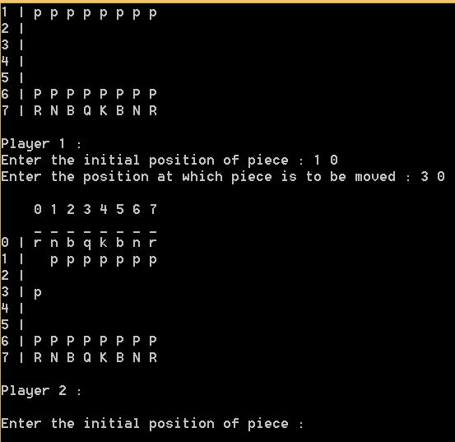
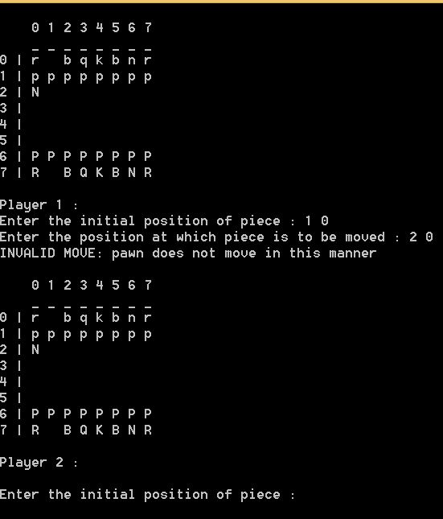
Understanding Movement.
We have made separate header files for each piece for implementation of their individual movement.
For pawn, the simple logic is that if the column of final position is +1 or +2 to the column of final position, it will swap, else it will show error.

Slide 2
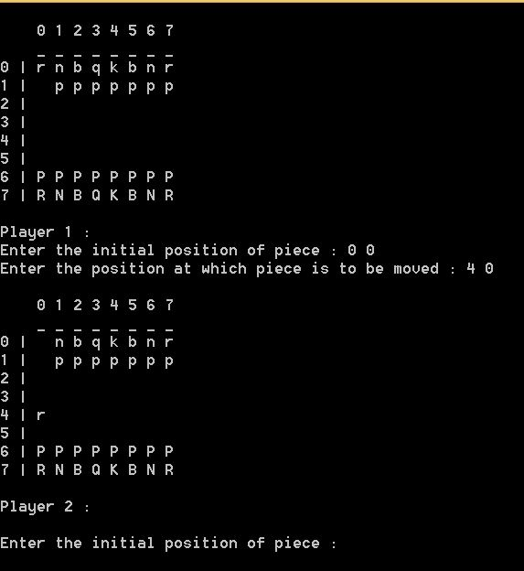
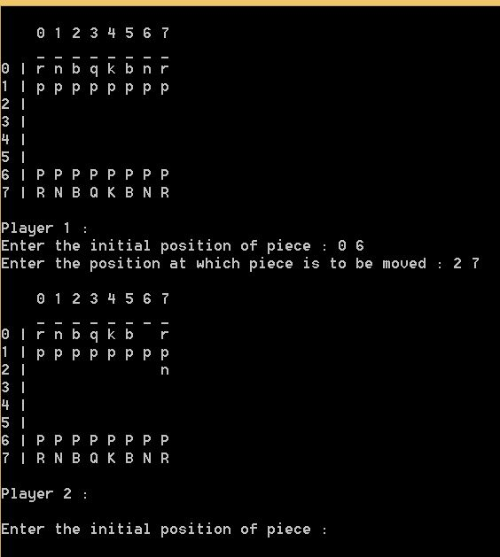
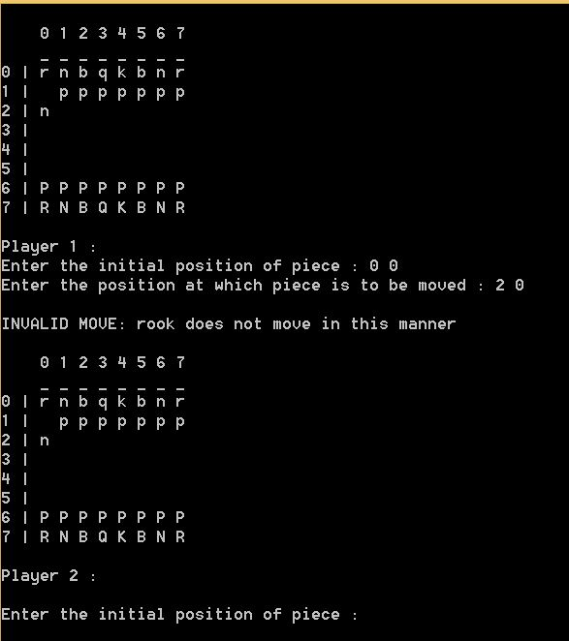
Movement (contd.)
The logic for checking the movement of rook is that if the co-ordinates lie in a vertical or horizontal straight line then the earlier declared variables on addition/subtraction with the initial co-ordinates will be equal to the final co-ordinates entered.

Slide 3
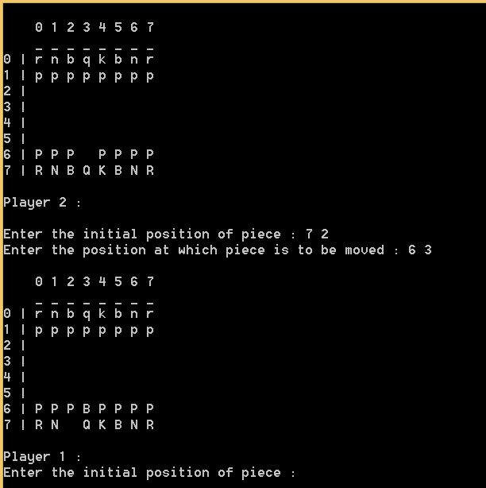
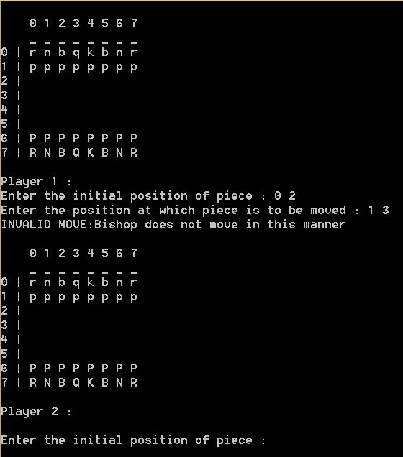
Movement (contd.)
For Bishop, we know that the it moves diagonally so if we consider the movement of the bishop as a straight line, y=mx+c then the slope of that line can either be 1 or -1 so now we only need the constant c which is initial position.

Slide 4
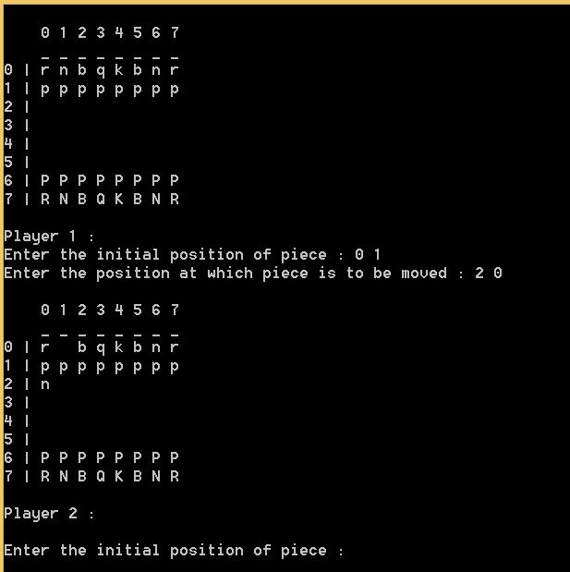
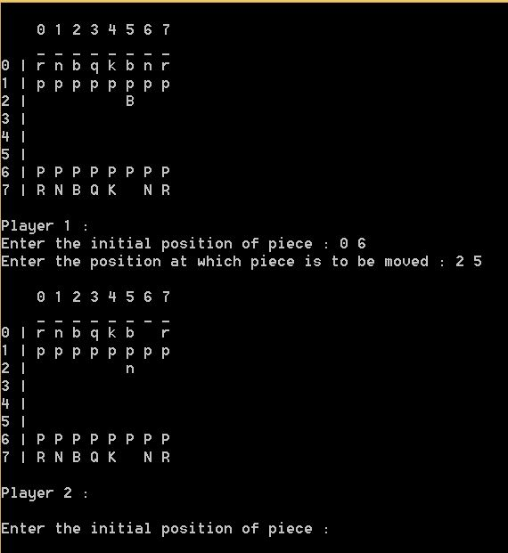
Movement (contd.)
For Knight, if the final column is +2 to that of initial and the final row is +1 to that of initial row, it will execute.
In other case, if the final column is +1 to that of initial and the final row is +2 to that of initial row, it will execute. In all other cases it will diplsy error.

Slide 5
Checking Check.
The main idea behind the check is that for the piece in consideration we just check if the king is lying on the path on which the selected piece can move if the king lies on the path of the movement of the selected piece's then the function that is called will return 1. i.e. true else the function will return false.
Also, if there’s check, it will restrict all other pieces except the one that can protect the king.

Slide 6
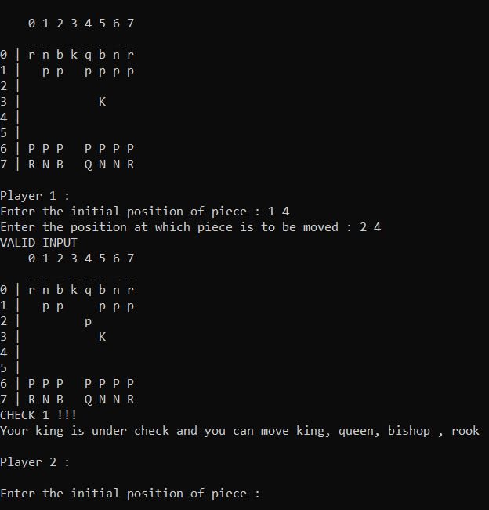
Check (contd.)
The pawn can only check the king in only two ways i.e firstly the king should be diagonally below the pawn's final position to the left or to the right i.e (2,1) and the enemy king should be at either (3,0) or (3,2) if this condition is true than the function returns true i.e. 1 else false i.e. 0.

Slide 7
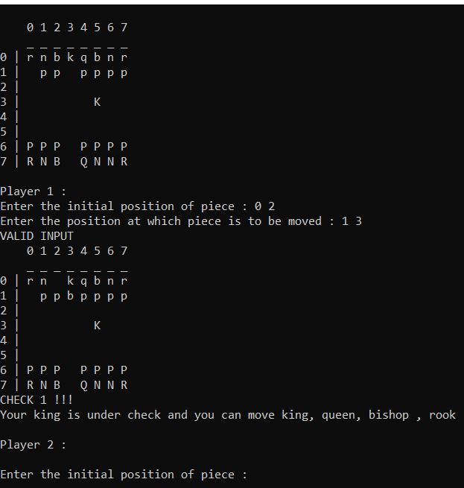
Check (contd.)
For Bishop, the main logic behind the bishop's check is that first we will calculate the enemy kings coordinates after that we will check all the direction in which the bishop can move to see if the king lies in that direction or not.

Slide 8
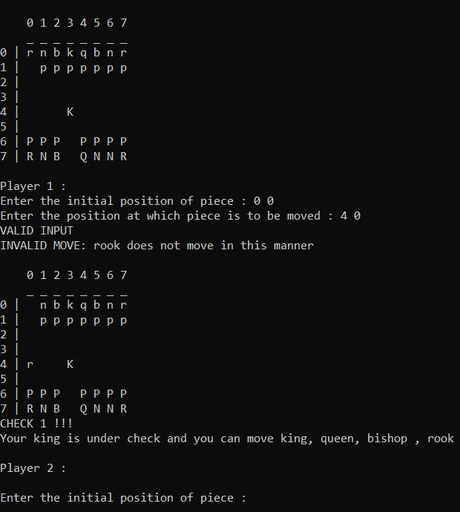
Check (contd.)
The logic applied for rook is that, Firstly we will be calculating the position of the enemy king then after the second step would be to king lies in which direction of the rook.

Slide 9
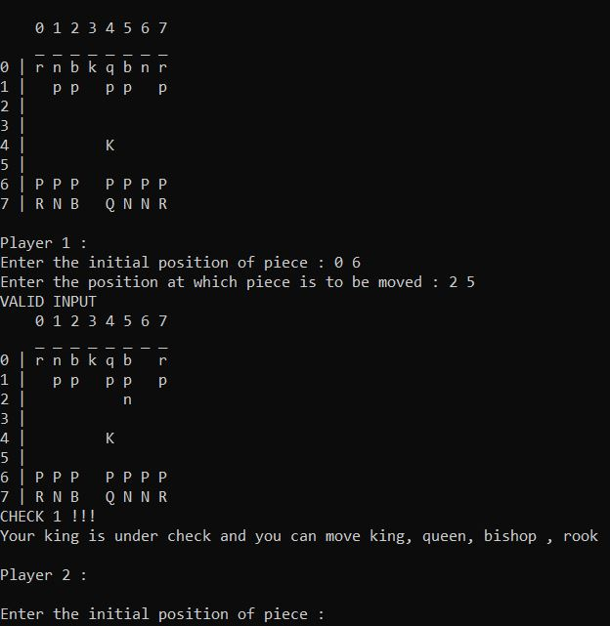
Check (contd.)
The logic behind the the movement of the knight is that we will first find the coordinates of the enemy king then we will check if the enemy king coordinates matches with the final coordinates of the knight if it does then we would simply return true else we would return false.

Slide 10
Understanding Checkmate.
The idea behind checkmate is that king has no possible moves to perform in any directions, as these tiles are occupied by same player’s pieces or are covered by opponent's pieces which are on some distance or by opponent's pieces itself.
Here we are taking another 2-D array of 3X3 of characters to denote the 8 tiles which can be accessed by the king for its movement.
If any tile is occupied by any other piece other than the king it considered a dead end which is denoted by a '-' and the available tiles are denoted by ' ' in the moves array.

Slide 11
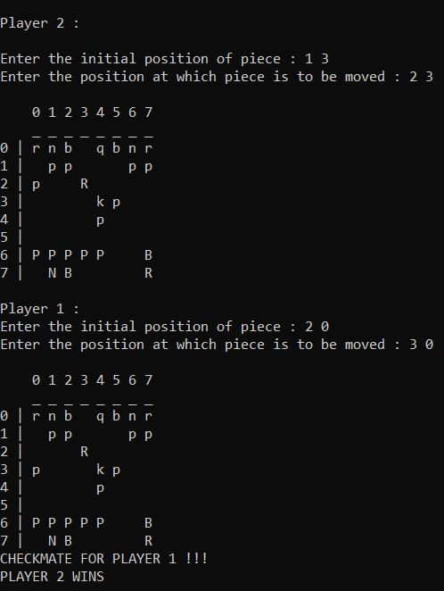
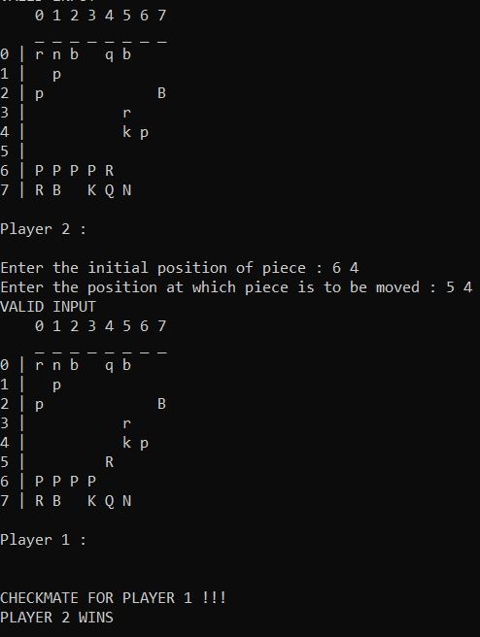
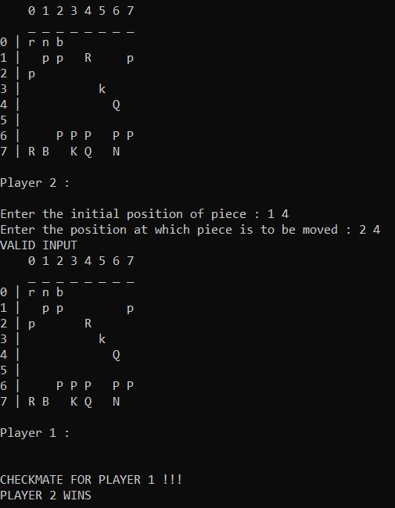
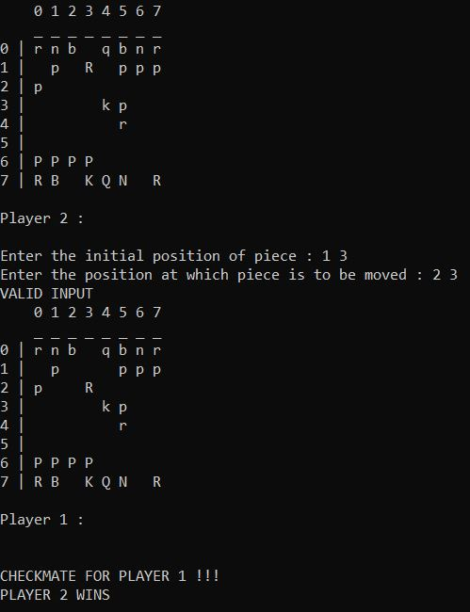
Checkmate (contd.)
After calculating all the blocked and available spaces for the king to move we decrement the possible moves counter which is initially assigned value 9, which is all the 8 movement direction of king and the tile occupied by the king itself.

